Slide 1
TNE20002/TNE70003
Topic 1: Routing

Slide 2
The Router
Routers
are the
core
of
The Internet

Slide 3


Routing
The Internet is too large to have all hosts together as one network, it is subdivided
Internet

Slide 4
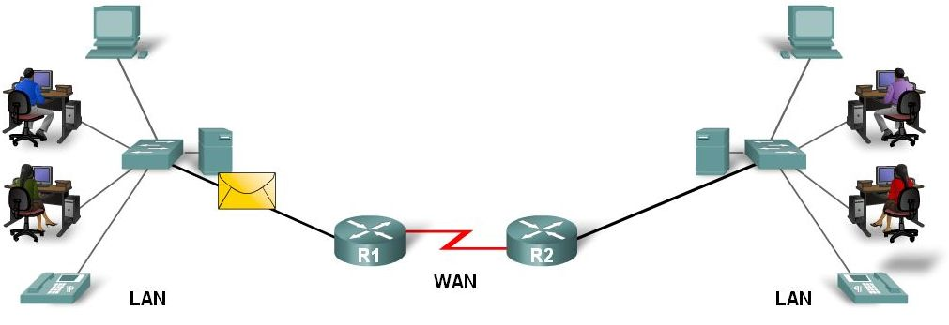
Routers connect Networks
The Internet is subdivided into many separate networks.
Each router interface Fa0/0, S0/0/0, etc is a Gateway to another a network
Internet
Network 1
IPv4 Class A 18.0.0.0/8
Network 3
IPv4 Class C 192.10.30.0/24
Network 2
IPv4 Class B 140.16.0.0/16
Switch
Switch
S0/0/0
Fa0/0
S0/0/1
Fa0/1

Slide 5
The Router
The router, routes IP packets to the intended destination
The router, drops IP packets to reduce congestion
Setting Time to Live (TTL) to 10 hops, means if the packet cannot reach its destination within 10 hops, it will be dropped
When a packet enters a router, deduct 1 from TTL
IF TTL = 0 the packet will be dropped

Slide 6
Network Topology
Nova
Router
R1
Magda
Router
R3
S0/2/0
S0/1/0
Sydney
Router
R4
S0/1/1
S0/1/0
<- Hop →
<- Hop →
G0/0/1
S0/1/0
S0/1/1
G0/0/1
Inter-VLAN
Routing
<- Hop →
<- Hop →
Inter-VLAN
Routing
S0/1/1
G0/1
Jatai
Router
R2
Sydney
Switch S4
2960
S0/1/0
G1/0/11
Routing Protocol
RIPv2
Fa 0/24
G0/0/1
Nova
Switch S1
3650
Inter-VLAN
Routing
G0/1
PC3
VLAN66
G1/0/13
Address Space
IPv4 Class B 172.16.0.0/16
Jatai
Switch S2
2960
182.16.66.0/24
PC1
VLAN77
Fa 0/24
PC2
VLAN55
182.16.77.0/24
182.16.55.0/24

Slide 7
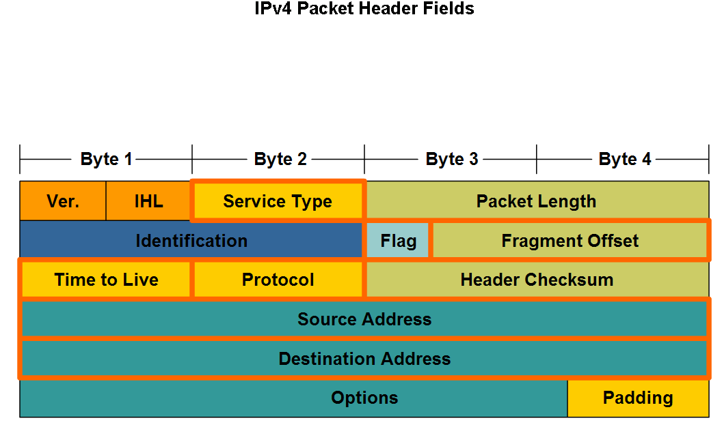
IP Header TTL
TTL

Slide 8
Routing Decisions
Based on the Information in the Routing Table, the Router
Makes a Best Match Decision
It determines the Best Match, between the destination network address in the incoming packet and a network address entry in the routing table
Makes a Forwarding Decision
It determines the correct exit interface then forwards the packet to that exit interface (R1 S0/1/1 pg 6), towards the destination network.

Slide 9
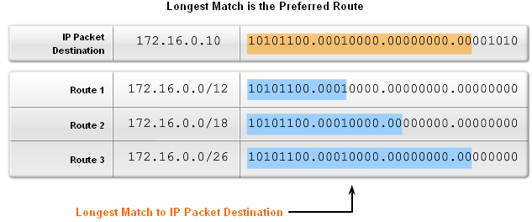
The Router - Best Match Decision
The Best Match is the one that has the most number of bits (left to right) matching between the destination IP network address and a routing entry in the Routing Table.
Best
26 bits
12 bits
18 bits
26 bits
Best
26 bits Match

Slide 10
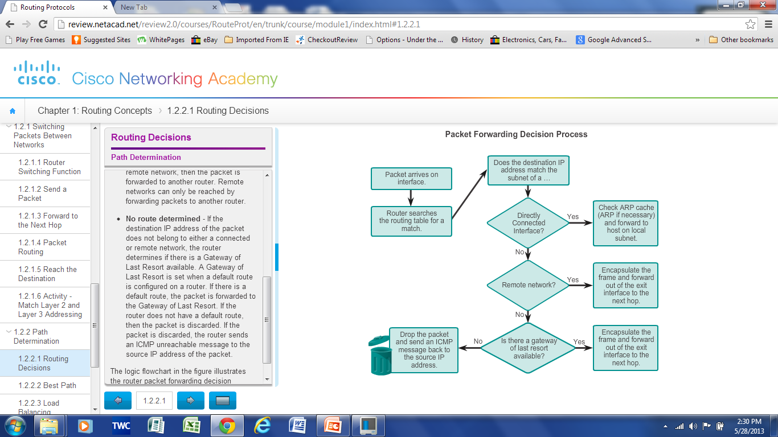
Routing Decisions – Flow Chart
Forwarding
Correct
EXIT Interface
Local Subnet
Search for
Best Match
Destination Unknown
Default Route
Notes:
1.2.2.1 Routing Decisions

Slide 11
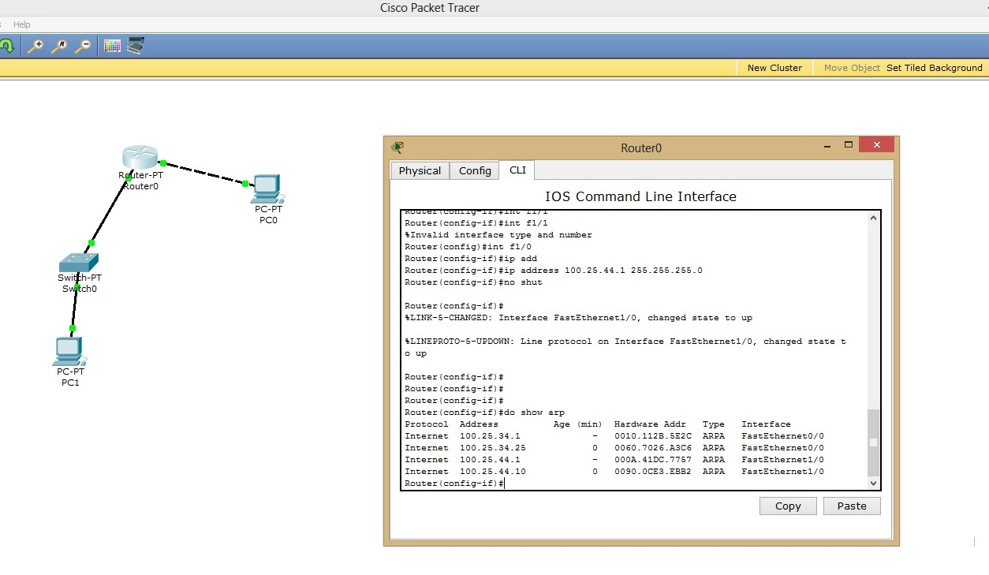
Router ARP Table – Local Subnets
Forwarding a packet through FastEthernet Interfaces
Display ARP Table on Router - show arp (Mapping IP to Mac)
34.25
44.10
Two Local Subnets
100.25.34.0/24
100.25.44.0/24

Slide 12
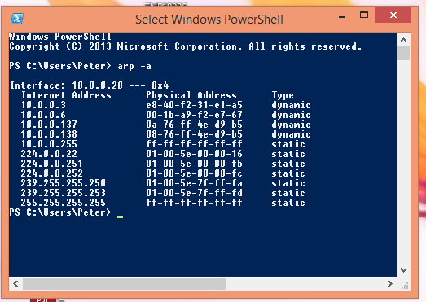
PC ARP Table
Display ARP Table on PC in Command Window - arp -a

Slide 13
The Router
The
Routing
Protocol

Slide 14
Path Determination - Least Cost Path
The Least Cost Path to a given network is determined by a routing protocol calculating the cost.
The cost calculation can involve a number of metrics.
The Least Cost Path to a network is the path with the lowest cost.
Notes:
1.2.2.2 Best Path

Slide 15
Metrics
Hop Count: counts the number of routers a (IP) packet must traverse
Bandwidth: Influences path selection by preferring the path with the highest bandwidth
Load: Considers the traffic utilization of a link
Signal Delay: Considers the time a packet takes to traverse a path
Reliability: Assesses the probability of a link failure

Slide 16
Cost
The
COST
is
calculated
based on the
metrics
used by the
Routing
protocol

Slide 17
Dynamic Routing Protocols
Routing Information Protocol
RIP
cost
based on metric
Hop count
Notes:
1.2.2.2 Best Path

Slide 18
Dynamic Routing Protocols
Open Shortest Path First
OSPF
cost
based on metric
bandwidth
from source to destination
Notes:
1.2.2.2 Best Path

Slide 19
Dynamic Routing Protocols
Enhanced Interior Gateway Routing Protocol
EIGRP
cost
based on metrics
Bandwidth, delay, load, reliability
Notes:
1.2.2.2 Best Path

Slide 20
Routing Table - Least Cost Paths
Only the
Least Cost paths
to given destination networks,
as determined by a routing protocol,
are placed in
the routing table
Notes:
1.2.2.2 Best Path

Slide 21
The Router
The
Routing
Table

Slide 22
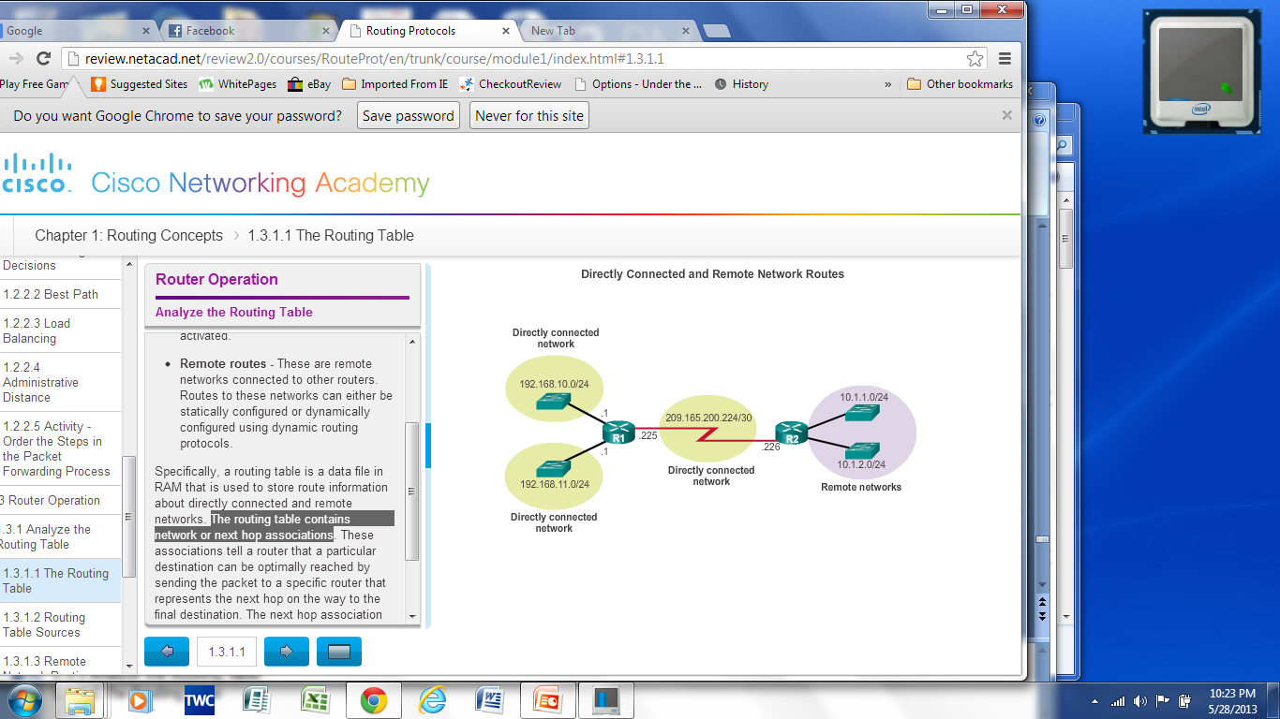
The Routing Table – R1
A routing table for R1 is a file stored in RAM that contains information about:
Directly connected routes
Remote routes (learnt via routing protocol)
Next hop associations
Notes:
1.3.1.1 The Routing Table

Slide 23
Routing Table Entries – show ip route
Link local route interfaces - Added to the routing table when an interface is configured. Shows IP address of the Interface.
Connected interfaces - Added to the routing table when an interface is configured and active.
Static routes - Added when a route is manually configured and the exit interface is active.
Dynamic routes - Added when RIP, EIGRP or OSPF are implemented and networks are identified.
Notes:
1.3.1.2 Routing Table Sources

Slide 24
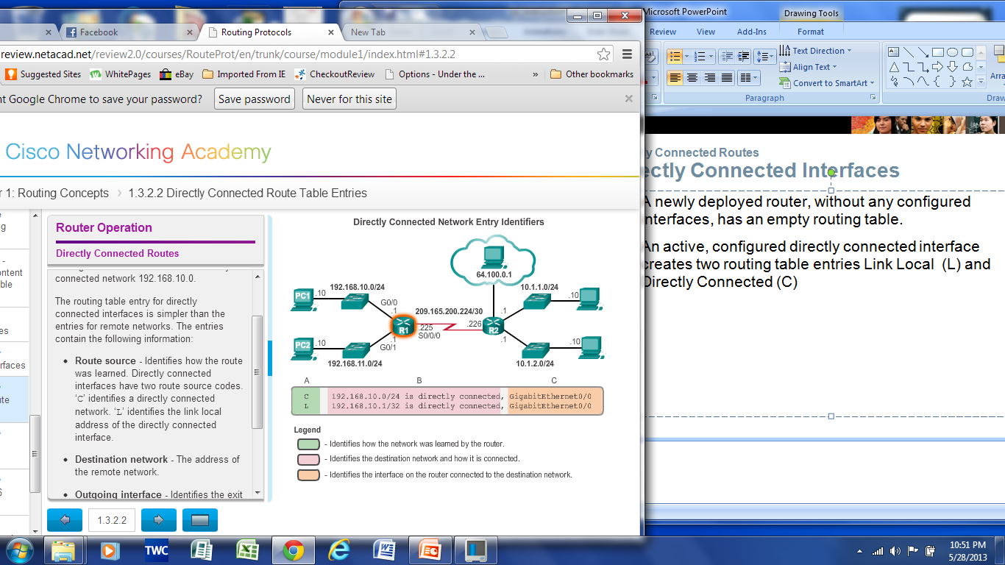
Directly Connected Routes – R1
An active, configured, directly connected interface creates two routing table entries:
Link Local (L) and Connected (C)
Notes:
1.3.2.2 Directly Connected Interfaces

Slide 25
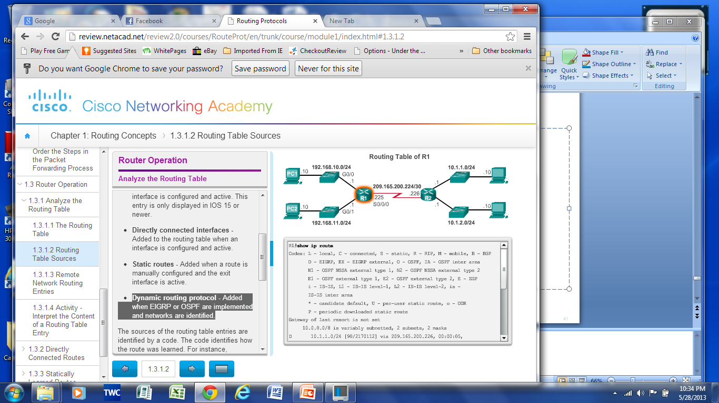
Routing Table Entries – R1: Remote Network
Remote Network
Notes:
1.3.1.2 Routing Table Sources

Slide 26
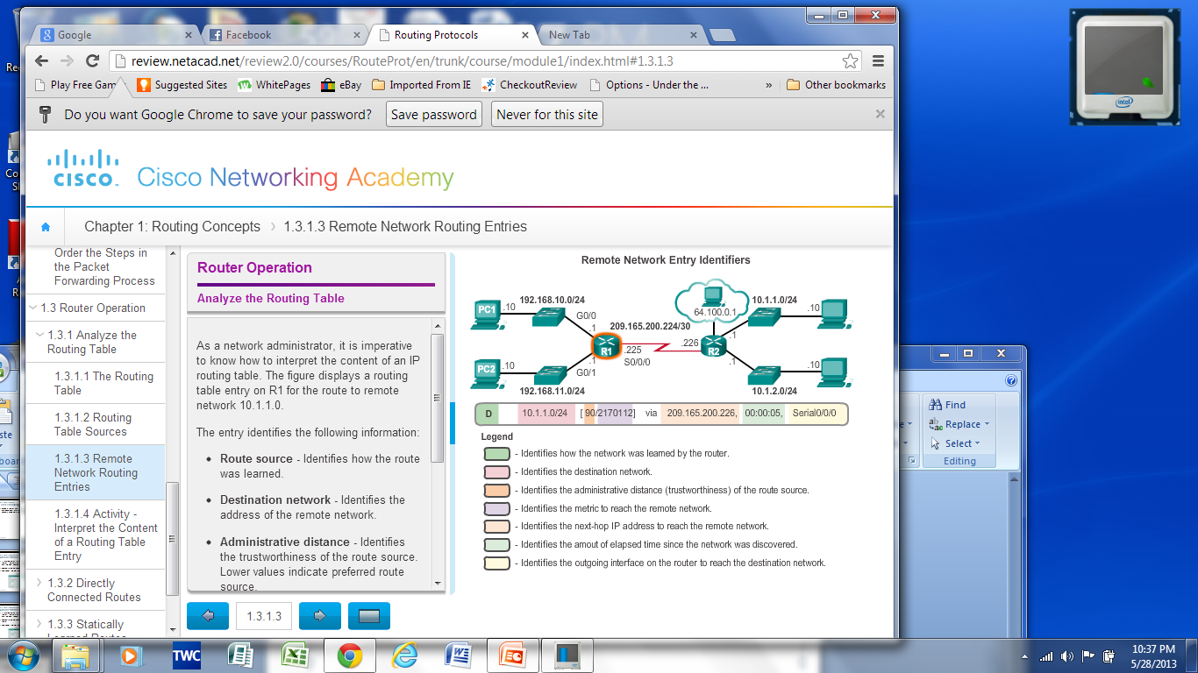
Routing Table Entries – R1: Remote Network
Interpreting the entries in the routing table.
Remote Network
D - EIGRP
Notes:
1.3.1.3 Remote Network Routing Entries

Slide 27
THE END

